Slide 1
Customer Booking Analysis
Data Preprocessing, Exploratory Data Analysis, and Model Training

Slide 2
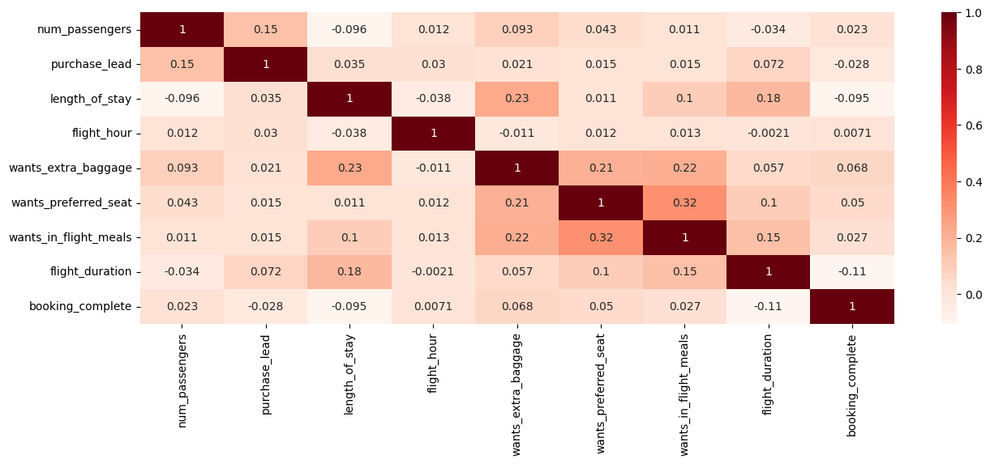
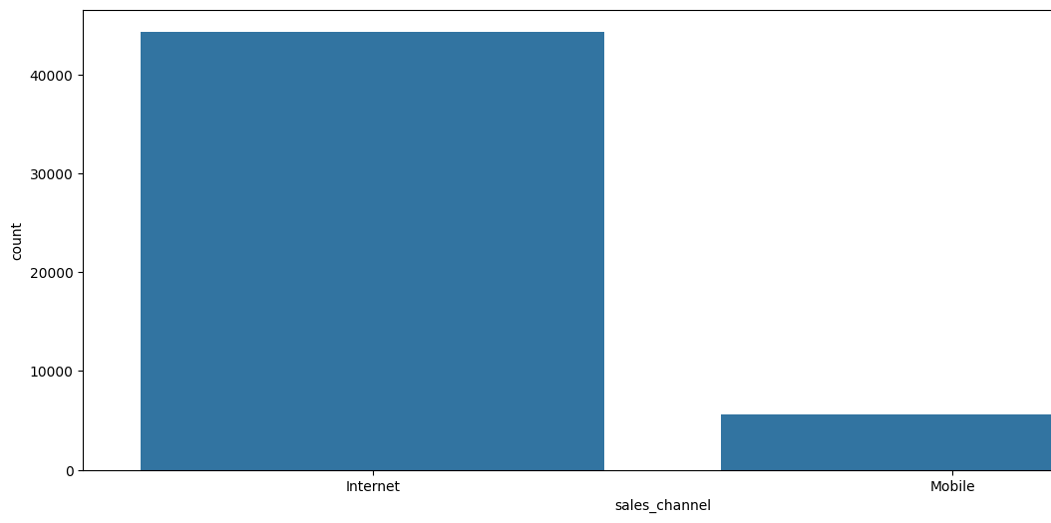
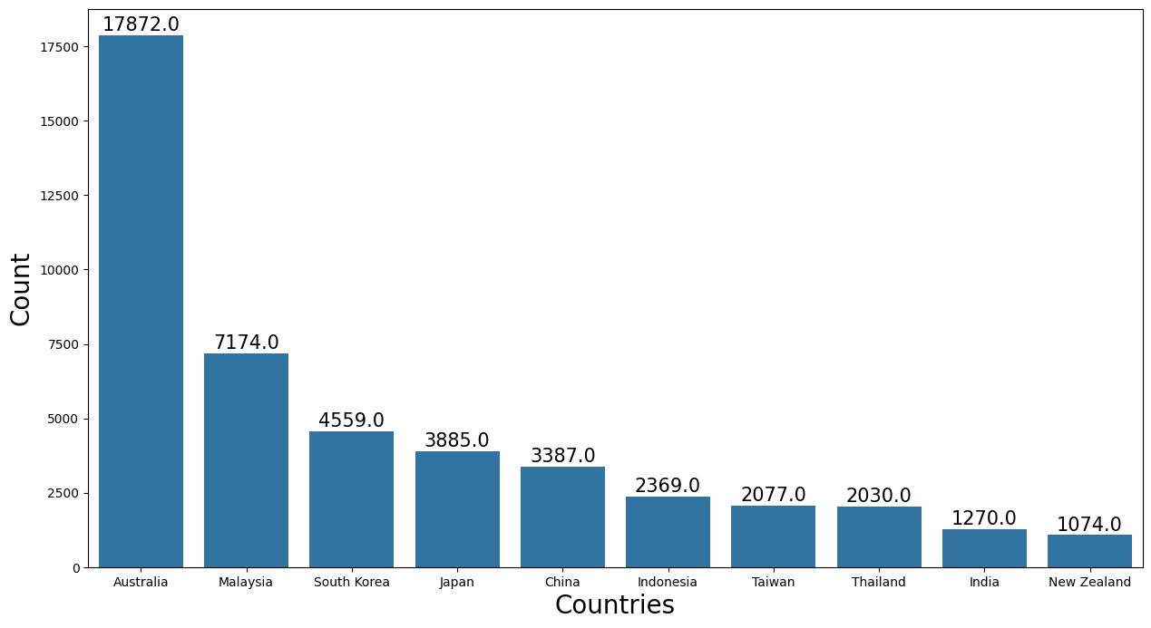
Key Visualizations and Findings
Heatmap of Numerical Features Correlation:
Visual representation of correlation between numerical features.
Insight into multicollinearity among features
Booking Channel Usage:
Most frequently used sales channels for flight bookings.
Top 10 Booking Origin Countries:
Countries with the highest number of flight bookings.

